Slide 1

Store ITEM Sales Prediction – Time series (ARIMA model)
Prepared By: Vineeta Nair

Slide 2
Table of Contents
Dataset Description & Objective
Prediction of 3 months Sales
EDA
Sales Data Distribution
Yearly Sales between 2013 – 2017
10 highest monthly Sales Trend
Quarterly Sales Trend
Top 10 Most Expensive Items Sold
Stores with highest Sales
Items sold in each Quarter/Year
Total selling price of each item
Time Series Analysis
Decomposition
Stationarity Check
Data Transformation to achieve Stationarity
ARIMA Model Evaluation, Prediction & Reverted Prediction
Conclusion
Store & Item Weekly & Day-wise Sales Prediction
EDA
Store Sales Trends
Item Sales Trends
Store & Item variability
Day of Week variability
ARIMA Model Evaluation, Prediction & Reverted Prediction
Conclusion & References

Slide 3
Dataset Description & Objective
The objective of this project is to predict 3 months of item-level sales data at different store locations.
Data fields consists of:
date - Date of the sale data. There are no holiday effects or store closures.
store - Store ID
item - Item ID
sales - Number of items sold at a particular store on a particular date.
This dataset consists of 913k rows and 4 columns with 3 numerical and 1 object data types.
This is a clean dataset with no null values.

Slide 4

3 monthly Sales Prediction

Slide 5
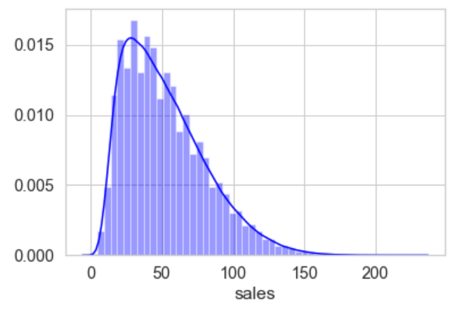
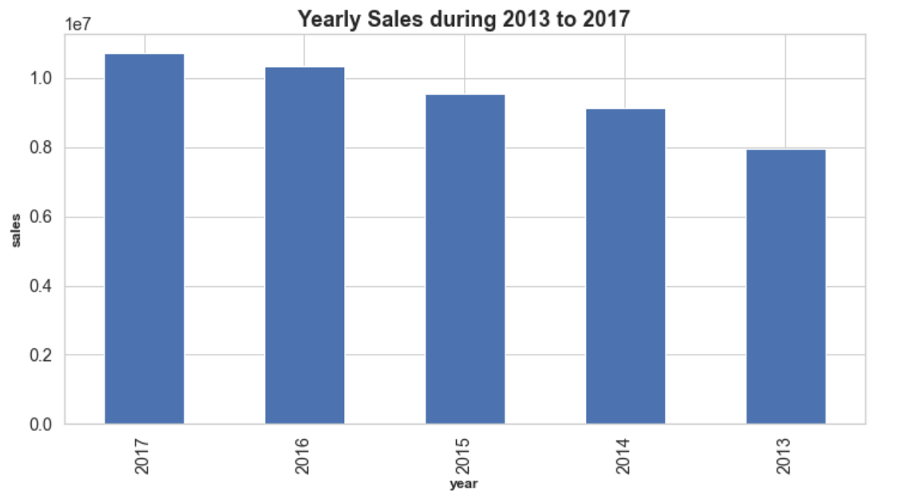
EDA – Sales Data Distribution & Yearly Sales Trend
The Sales column is positively left skewed with median at 47 and maximum at 231. The same is depicted in the graph below.
2017 shows the highest sales with 10.7mn.

Slide 6
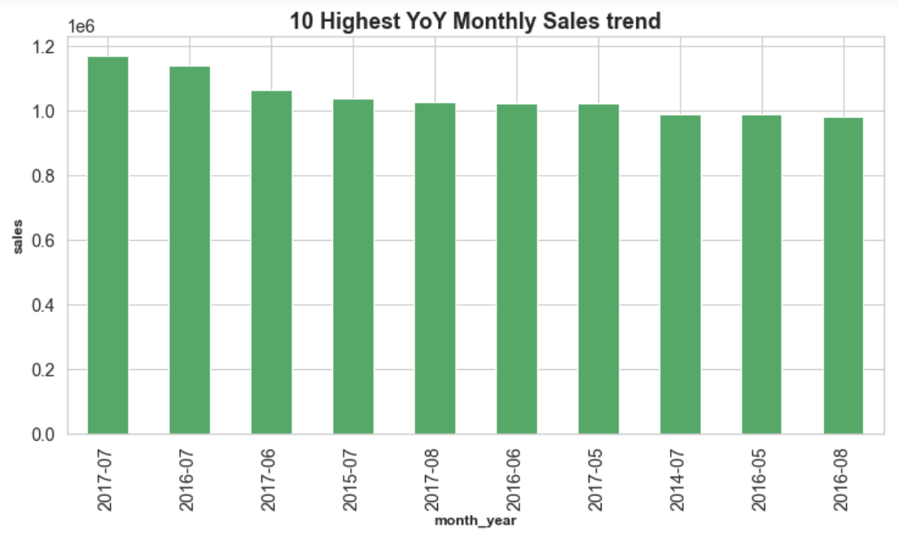
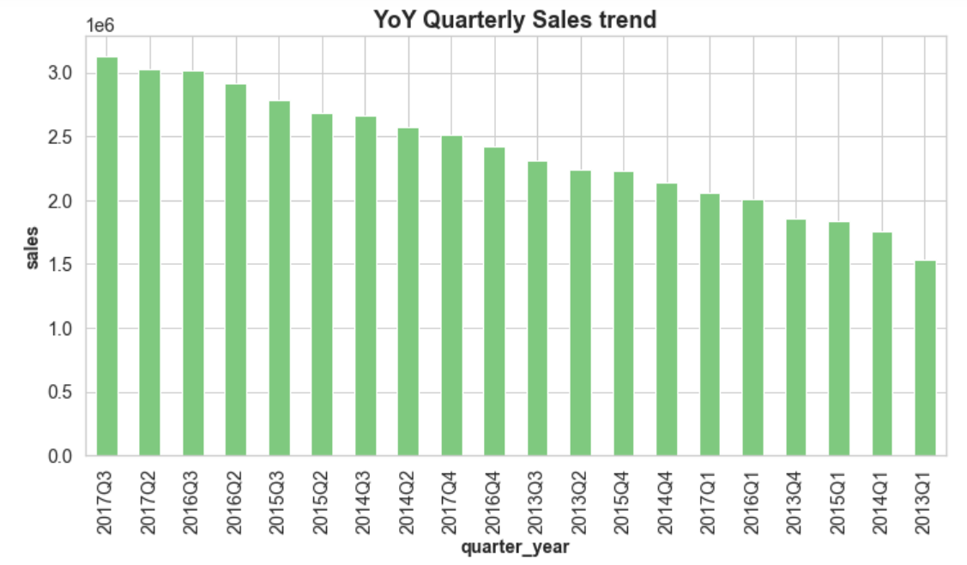
EDA – Monthly & Quarterly Sales Trend
Mostly each year shows highest sales in July month.
However, July 2017 depicts highest sales.
Q2 & Q3 has recorded high sales consistently since 2014.
2017 also has recorded the highest sales in Q3 of 3mn.

Slide 7
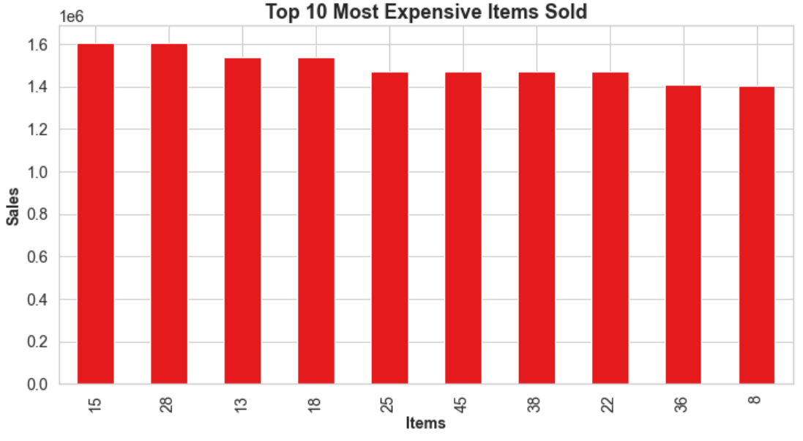
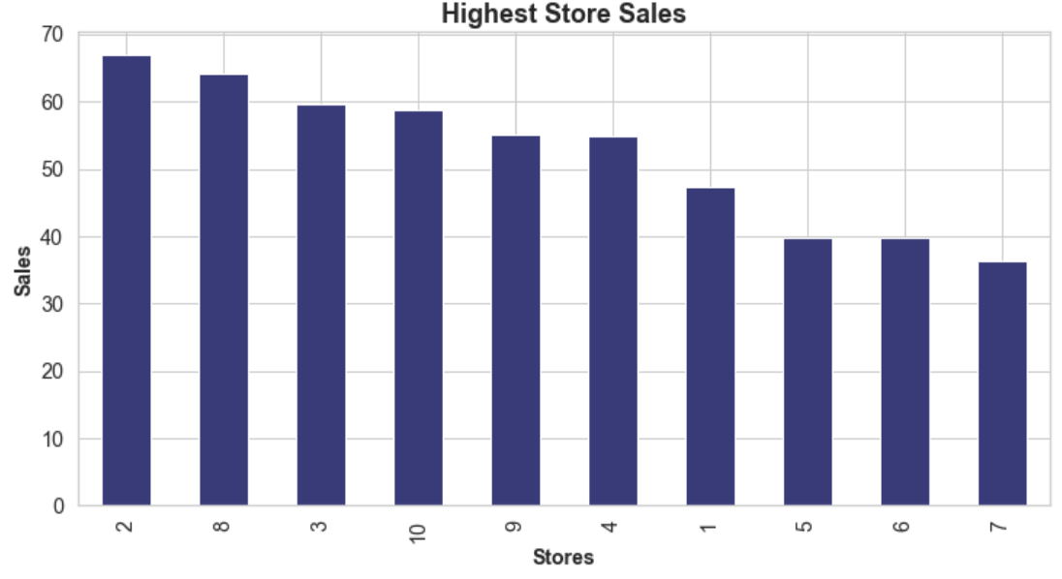
EDA – Most Expensive items sold & Store with highest sales
Most expensive items sold were Item# 15 & 28 for total 16mn each.
Store# 2 recorded highest sales with average sales of 67.03mn.

Slide 8
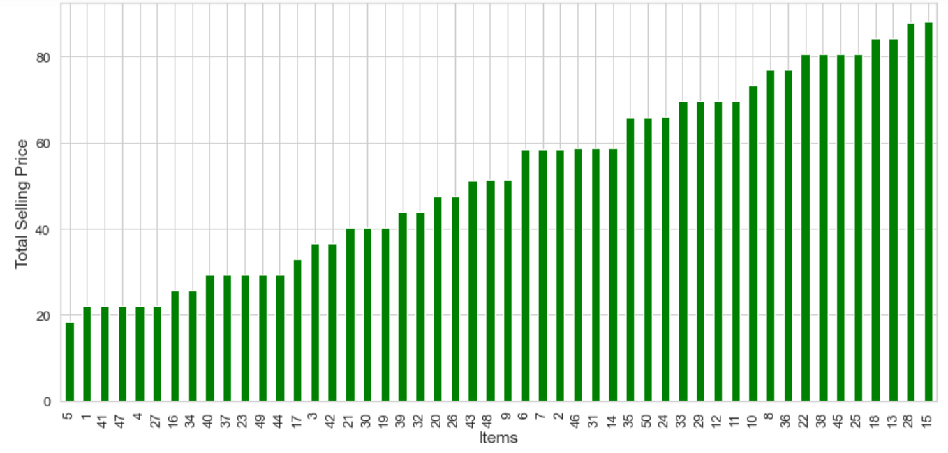
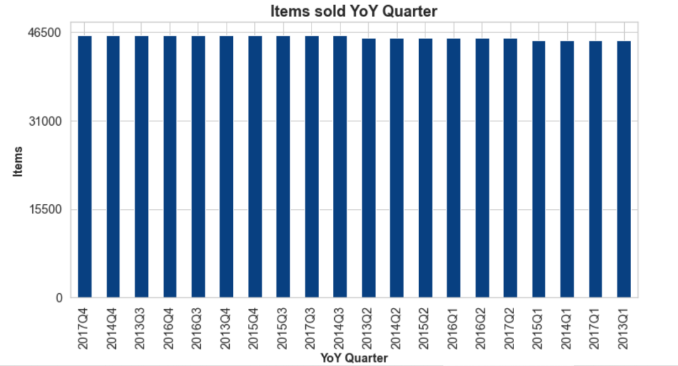
EDA - Items sold Quarterly & Total selling price of each item
Out of total selling price of each item, item# 15 was sold at 88.03 & item# 28 at $87.88/-
Cheapest item sold was item#5 at $18/-
Items sold in each quarter/year is uniform.
In Q1 & Q2 each year, 45k items are sold, whereas in Q3 & Q4 more number of items are sold (46k items).

Slide 9
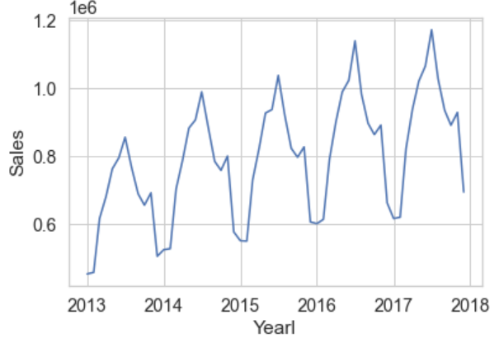
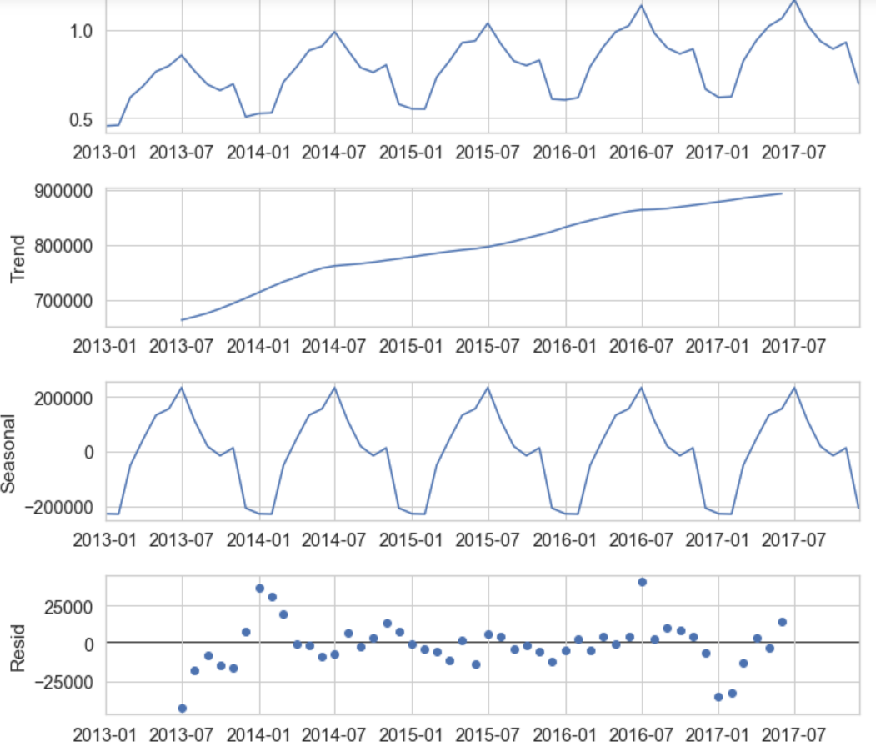
Time Series Analysis - Decomposition
Graph in the right shows the Trend component in the data.
Graph at the left shows the decomposed dataset by observed, trend, seasonal and residual component in the data.

Slide 10
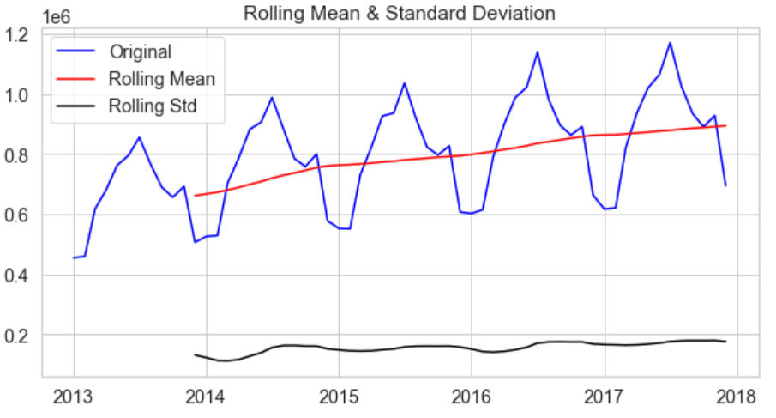
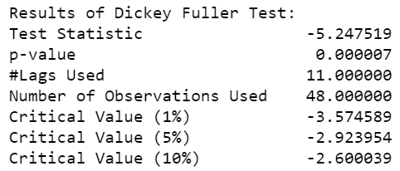
Stationarity check using Rolling statistics and ADF test
Rolling mean has a trend component
Rolling standard deviation is fairly constant with time.
Low p-value
Critical values (1%, 5%, 10%) are not close to the Test Statistics.

Slide 11
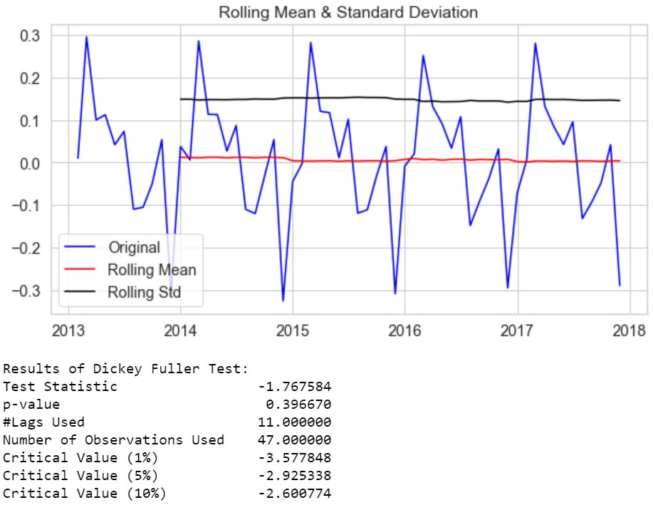
Data Transformation to achieve Stationarity
Time Shift Transformation
From above 2 graphs, we can see that, visually this is the best result as our series along with rolling statistic values of moving avg & moving std. dev. is very much flat & stationary.
p-value of 0.39 is not as good as 0.04 of ‘datasetLogScaleMinusMovingAverage’.
Test Statistic value is better than original but not as close to the critical values as that for exponential decay.
We have thus tried out 3 different transformation: log, exp decay & time shift. We will go ahead with the time shifted dataset.

Slide 12
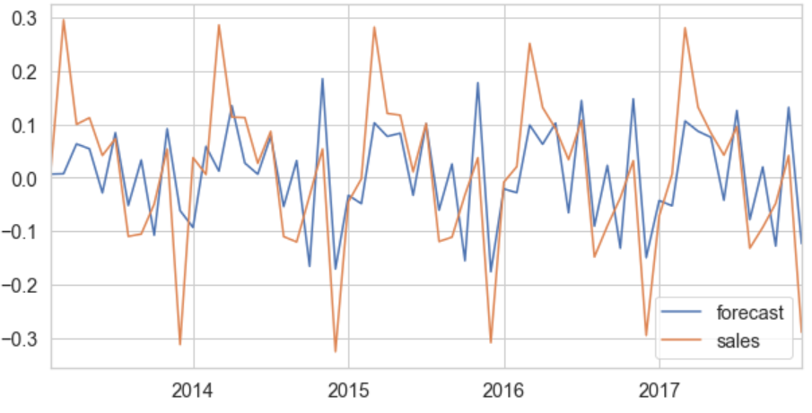
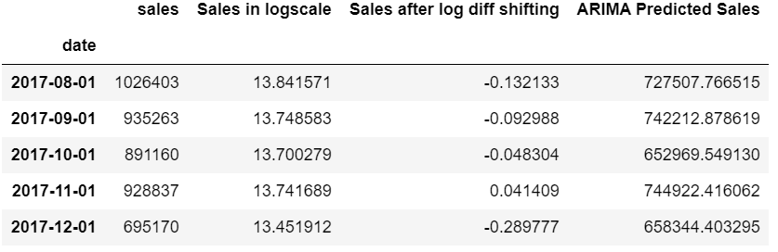
ARIMA Model Evaluation, Prediction & Reverted Prediction
ARIMA model used to predicted sales.
Model Evaluation using MSE with test score of 0.012
We see that our predicted forecasts are fairly close to the real time series values indicating a fairly accurate model.

Slide 13

Store & Item Sales Prediction

Slide 14
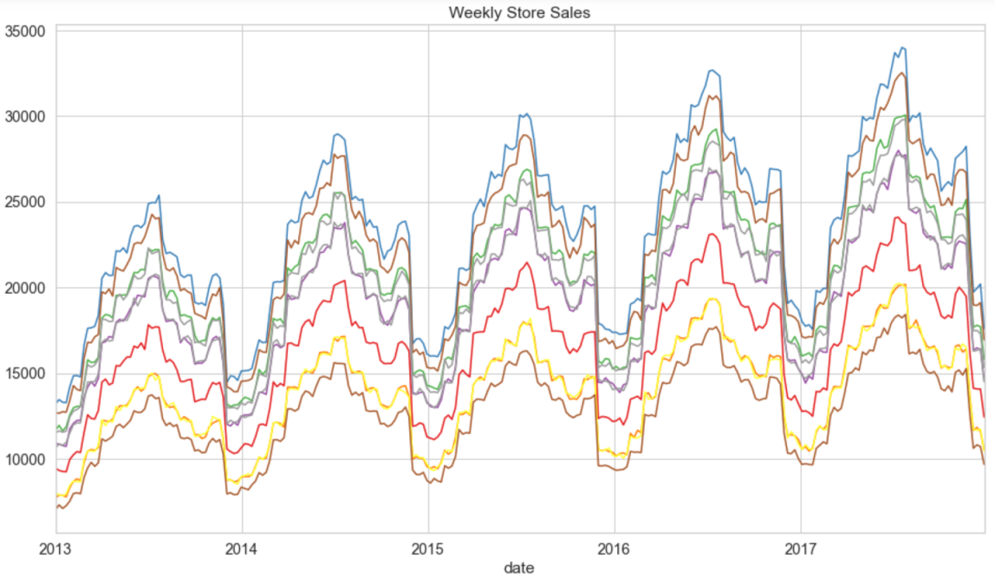
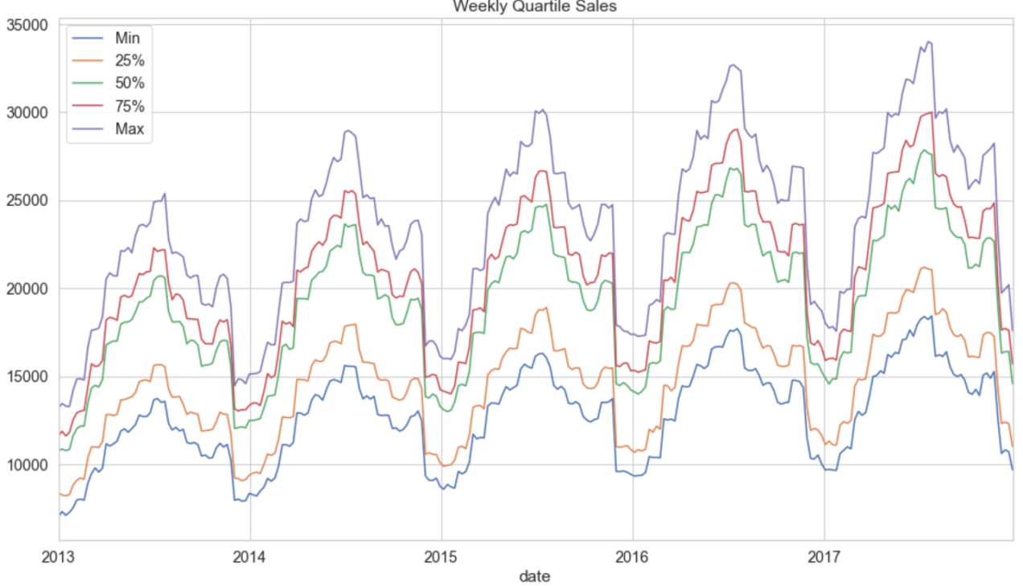
EDA – Store Sales Trend (Weekly Store Sales & Quartile Sales
The plot on the left shows every store's sales by week.
Right-side plot depicts weekly sales in each quartile.
We can see there's quite a gap between the 25% quartile and average.
However, as the other chart shows as well, each store shares a general seasonality.
They have highs and lows during the same periods of time.

Slide 15
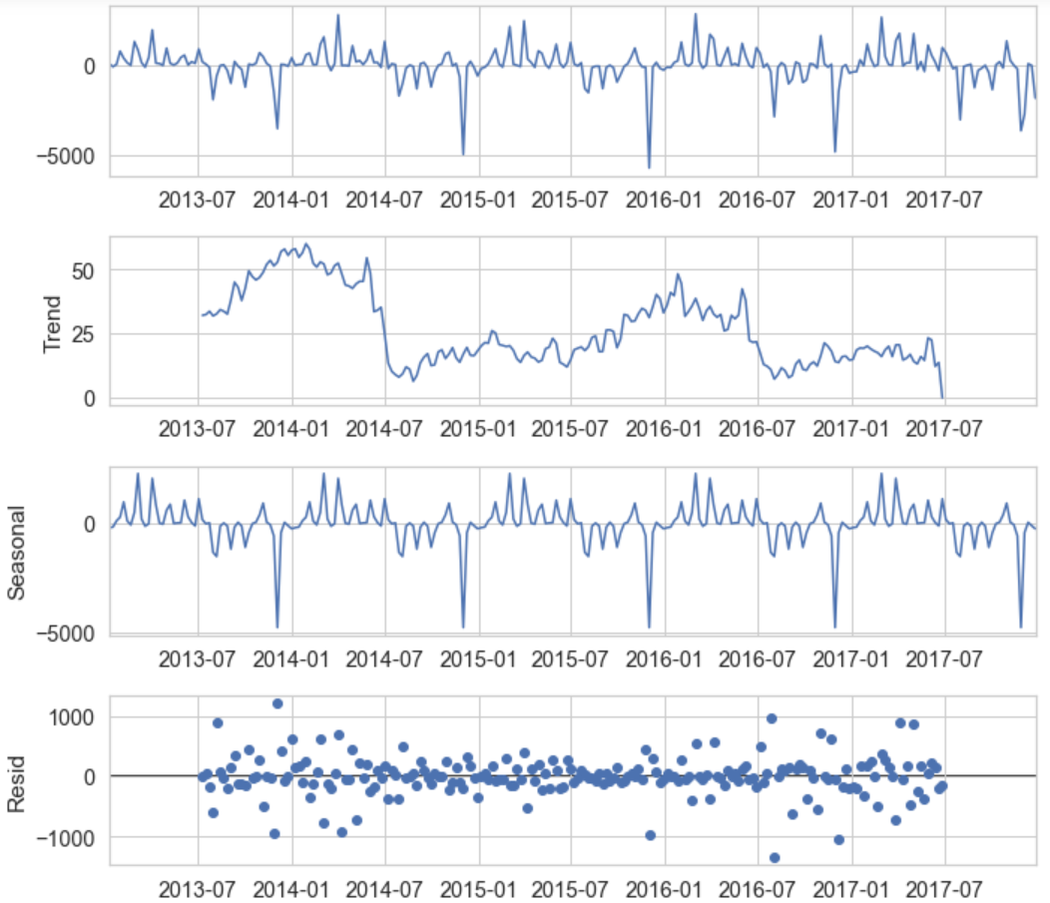
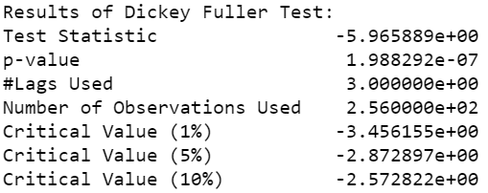
Additive Seasonal Decomposition of Average 'Store' Week-to-Week Sales
Additive Seasonal decomposition of Average Store week-to-week Sales shows the observed, trend, seasonal and residual components.
Post which, we performed the ADF test to check stationarity.
Result of ADF test:
P value at 1.9 is not good
Critical values (1%, 5%, 10%) are no where close to the Test Statistics.
Hence, we can say that, our Time Series is not stationary. There is definitely seasonality in the store sales.

Slide 16
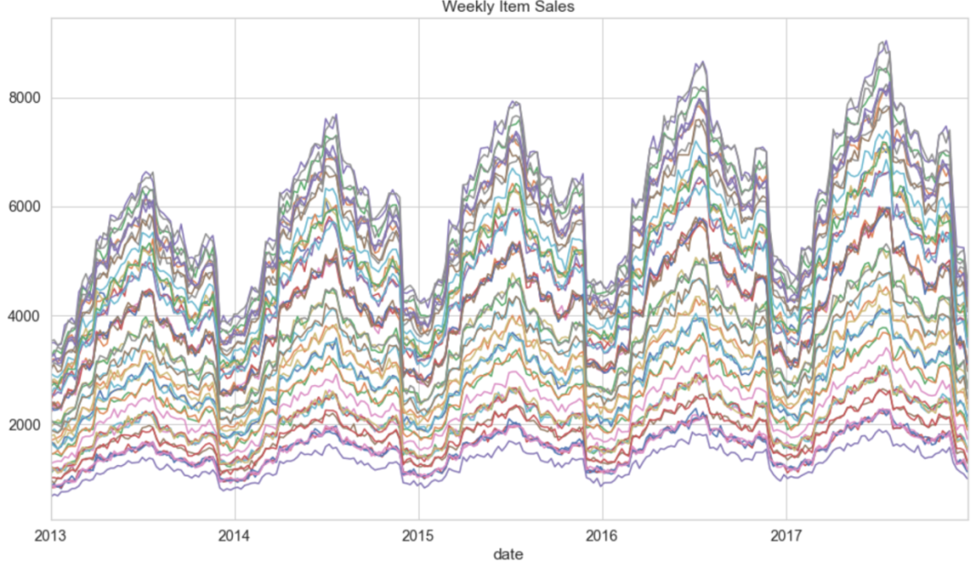
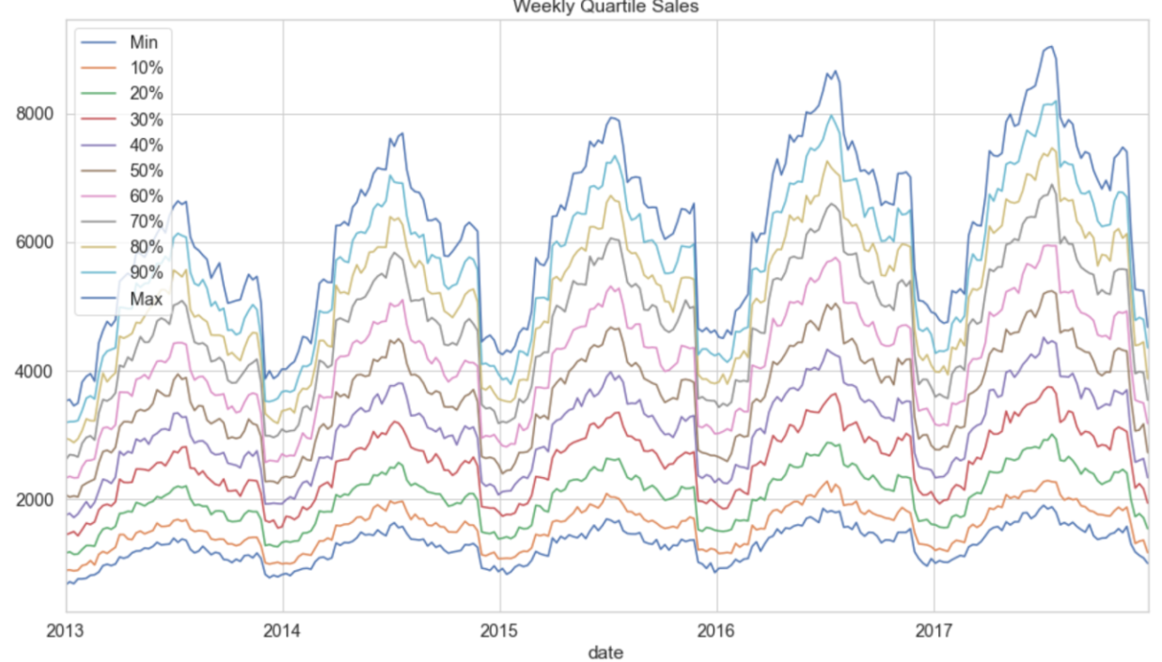
EDA – Item Sales Trends (Weekly Item Sales & Quartile Sales
Since there are more items than there were stores, we can look at more quartiles.
Let's see how every 10% quartile trends.
Like we saw in the store sales plots, there is seasonality in item sales.
Let's break out the seasonal component for the average like we had before..

Slide 17
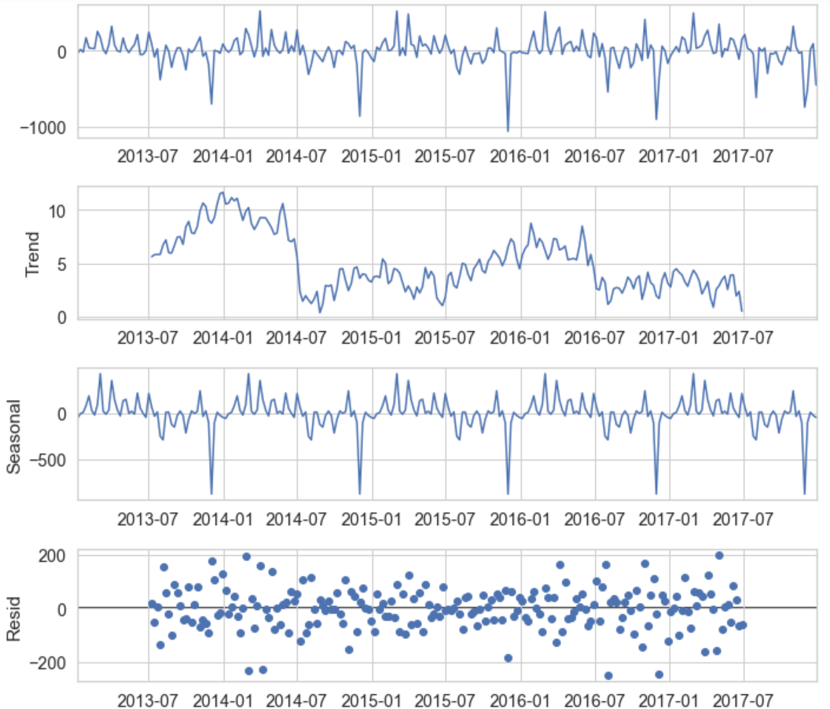
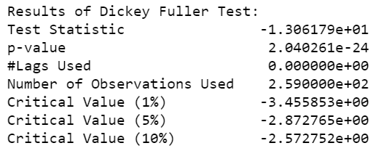
Additive Seasonal Decomposition of Average 'Item' Week-to-Week Sales
Item sales are also seasonal. No surprise there. Week-to-week differencing provides a dataset that is very likely to be stationary (< 1% chance that it's not).

Slide 18
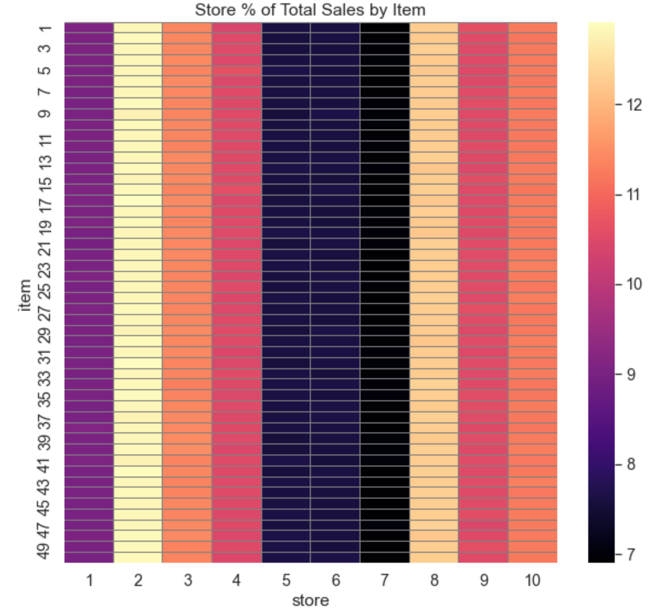
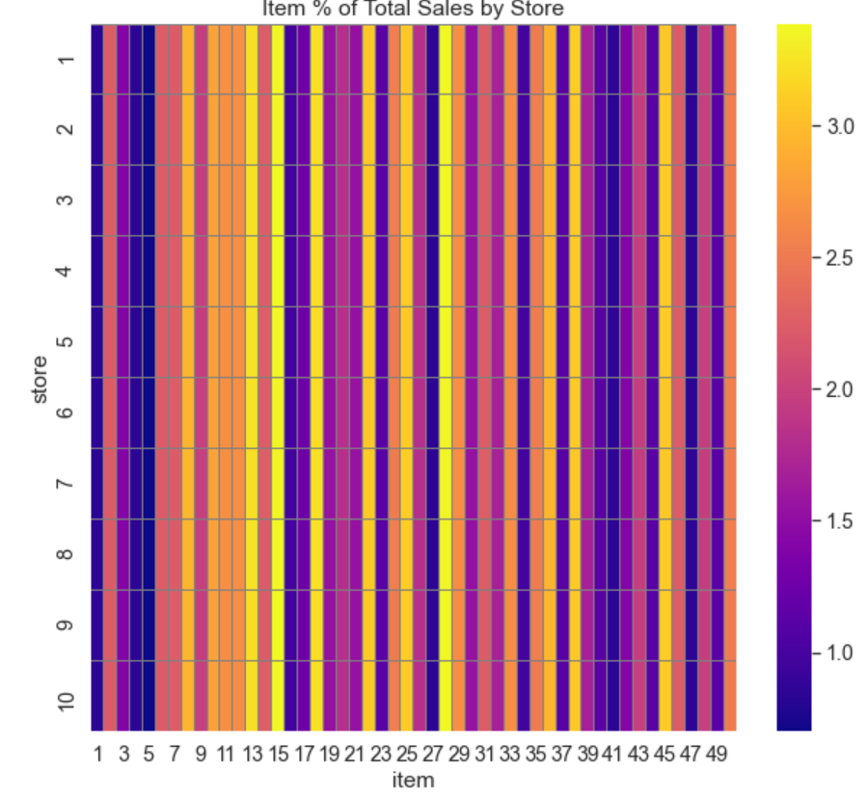
Store & Item Variability
Above is a plot for the % distribution of each item's sales across the stores (each row adds to 100%). As we can see, it's very uniform. The takeaway here is that the items are sold evenly across the stores.
We can see that each store overall sold roughly the same percentage of each item.
Store v/s Item Conclusion: Items have roughly same percentage sales across all stores. We could use this in our model.

Slide 19
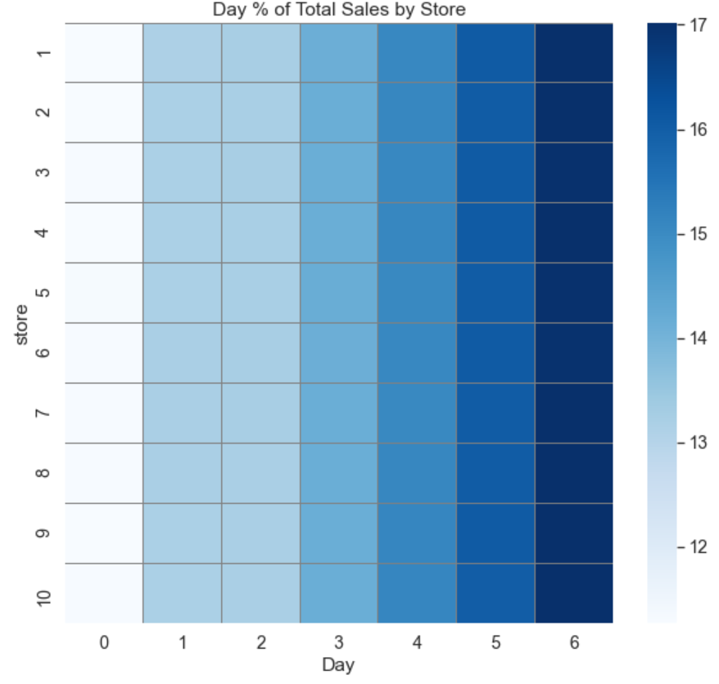
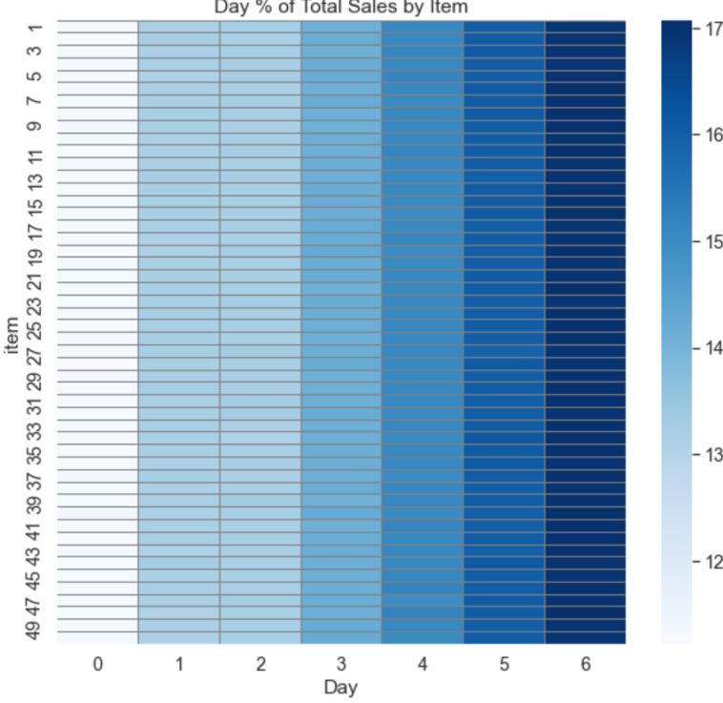
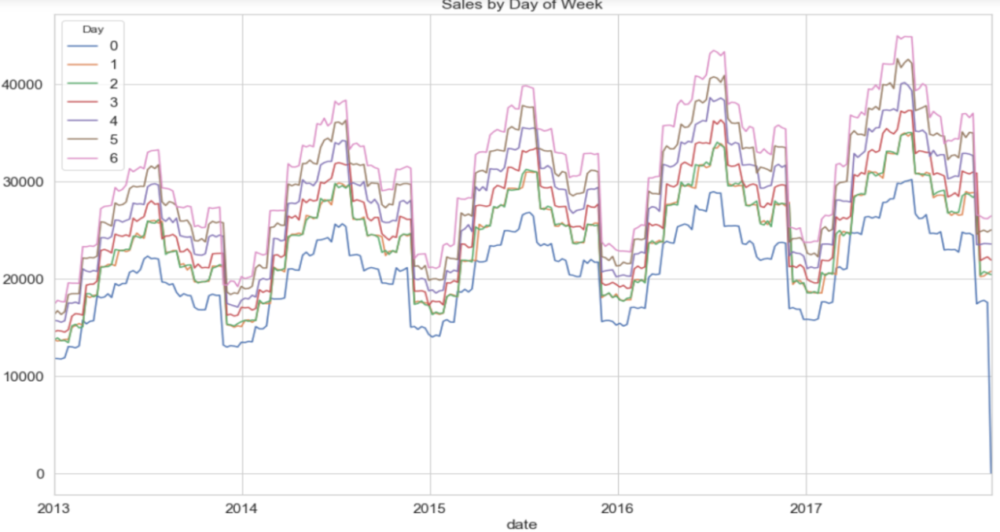
Day of Week Variability & Sales by Day of Week
The plot in the left shows the % mix of store sales by day. We can see that the stores are very similar in what days are popular.
Plot in the right tells us that each item's sales are nearly identical in terms of which days are more popular.
Day of week does impact sales, however all stores & items have similar distributions. Day of week trends follow general weekly trend.

Slide 20
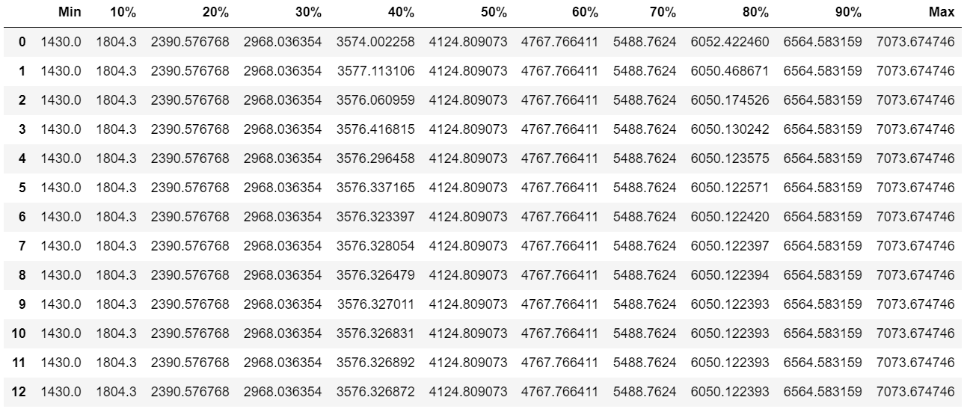
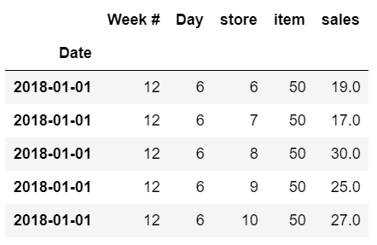
ARIMA Model Evaluation, Prediction & Reverted prediction
ARIMA weekly Predictions .
Table1 showing ARIMA predictions weekly trends at item level.
Item level day-wise predictions Jan-18
Table2 showing item level prediction day-wise for January 2018.
Model Evaluation using SMAPE: we get 19.49% error.

Slide 21
Conclusion & References
Conclusion: Though, ARIMA model took less time to predict; the accuracy score is very low. Hence, this is to conclude to predict Item level sales, we should explore other advanced Machine learning models like XGBoost which may give better accurate prediction.
References: Insaid LMS notebooks, Towards Data Science, Kaggle, Github and StackOverflow.

Slide 22
Thank you!

